Slide 1
Entertainer Data Analytics
Made by Preity Vasudevan Kondath

Slide 2
Introduction
The entertainment industry plays a significant role in our lives, providing us with movies, music, television shows, and other forms of entertainment that help us unwind and escape from the stresses of everyday life.
This project aims to delve into the careers of renowned entertainers, exploring various aspects such as their breakthrough moments, career durations, awards received, and trends over the years.

Slide 3
Details about Dataset
The project utilizes a dataset containing information about notable entertainers, including their names, genders, birth years, breakthrough moments, awards received, and years of last major work. The dataset encompasses a diverse range of entertainers from various fields such as music, film, television, and comedy.
Entertainer Details:
Name: The name of the entertainer.
Gender: The gender of the entertainer.
Birth Year: The year of birth of the entertainer.
Breakthrough Information:
Year of Breakthrough: The year when the entertainer achieved a significant breakthrough in their career.
Breakthrough Name: The name of the work or event that marked the entertainer's breakthrough.
Award Information:
Year of First Award: The year when the entertainer received their first major award (e.g., Oscar, Grammy, Emmy).
Award Type: The type of award received (e.g., Oscar, Grammy, Emmy).
Career Duration:
Year of Last Major Work: The year when the entertainer's last major work or project was released or aired.

Slide 4
Major KPI’s
Some major Key Performance Indicators (KPIs) that can be derived from the dataset and used to measure the success and impact of entertainers' careers include:
Age at Breakthrough: The average or median age at which entertainers achieve significant breakthroughs in their careers, providing insights into early or late career success.
Career Duration: The average or median duration of entertainers' careers from their breakthrough moments to their last major works, indicating the longevity and sustainability of their success.
Number of Awards: The total number of major awards (e.g., Oscars, Grammys, Emmys) received by entertainers, reflecting their level of recognition and acclaim within the industry.
Type of Awards: The distribution of different types of awards received by entertainers (e.g., Oscars, Grammys, Emmys), indicating their versatility and achievements across various fields.
Trend Analysis: Trends in breakthroughs, awards, and career durations over time, highlighting shifts and patterns in the entertainment industry and the evolving success factors.
Gender Distribution: The proportion of male and female entertainers in the dataset, providing insights into gender representation and opportunities in the industry.
Breakthrough Types: The distribution of different types of breakthroughs (e.g., successful films, hit songs, popular TV shows), indicating the diversity of paths to success in the entertainment industry.

Slide 5

Analytics Dashboard
28.64
Average Age of Breakthrough
34.74
Average Career Duration
1964
Average Year of Breakthrough
1998
Average Year of Last Work

Slide 6
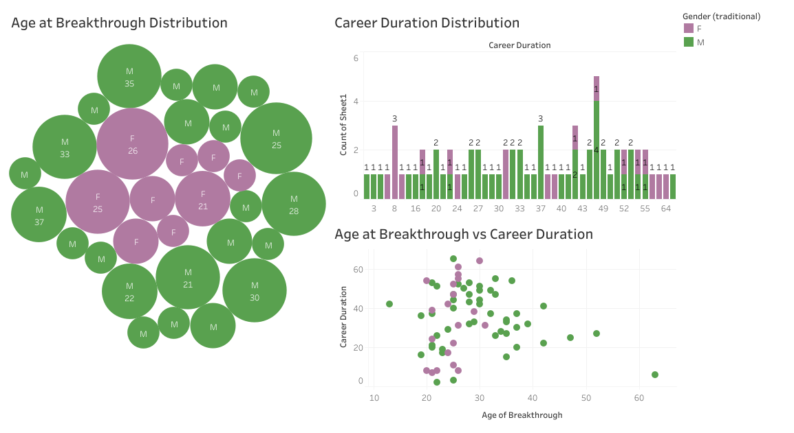

Slide 7
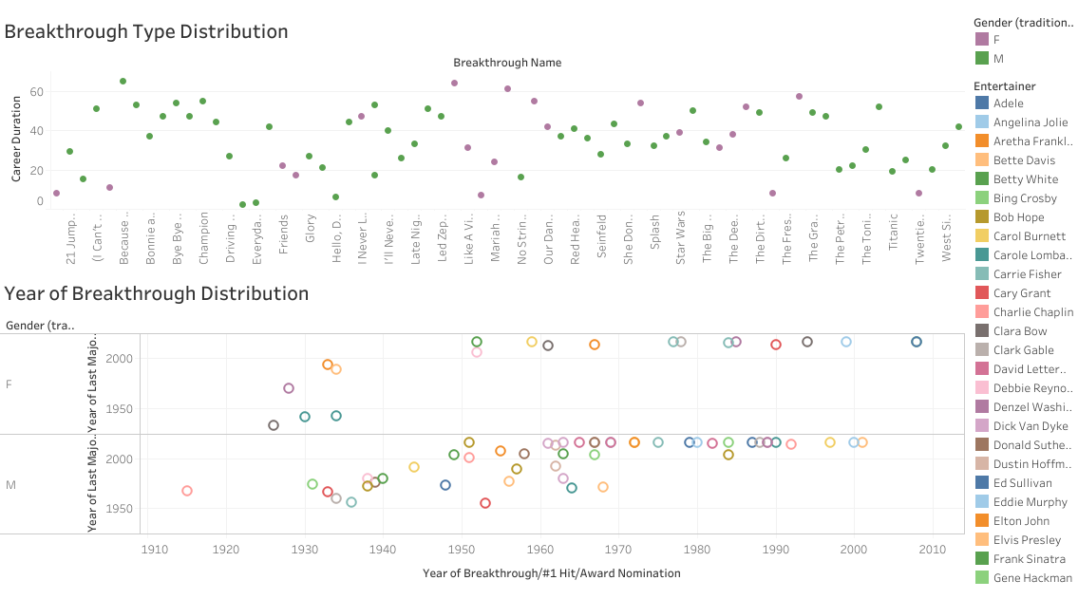
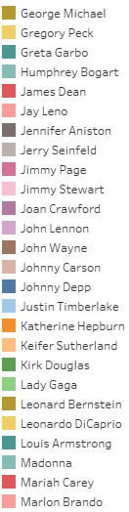
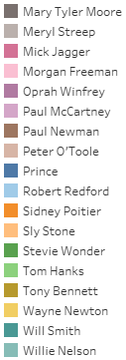

Slide 8
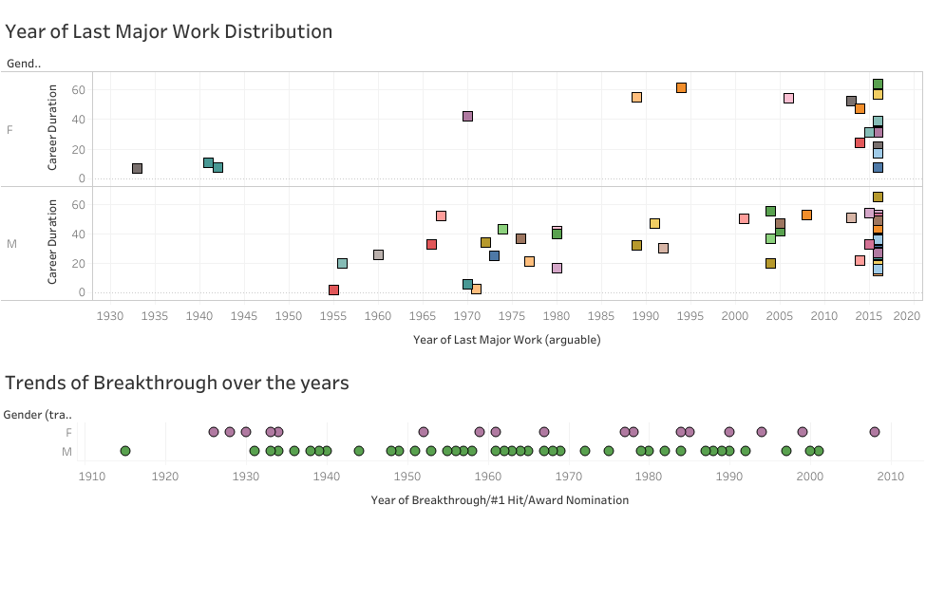
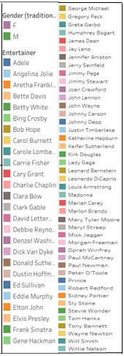

Slide 9


